Slide 1
Advanced Time Series Analysis
Prediction of Concurrent Radio Stream Listeners
by André Kern

Slide 2
The Idea

Slide 3
The Idea
How impacts the design of the musical program (internal factors) the listener counts?
→ Investigating listener counts based on external Factors like time related features

Slide 4
Dataset Description

Slide 5
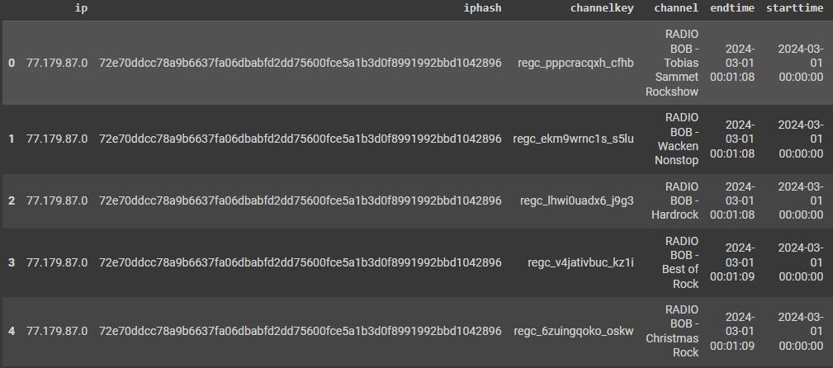
Dataset Description
Original Dataframe:

Slide 6
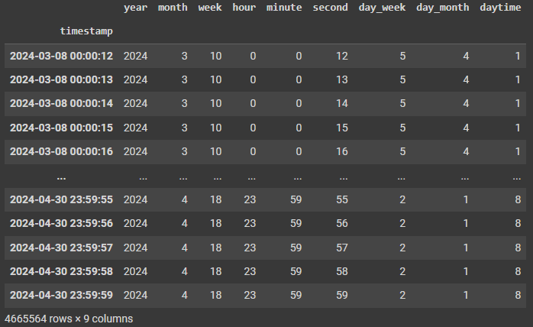
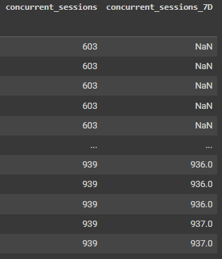
Dataset Description
Transformed Data:

Slide 7
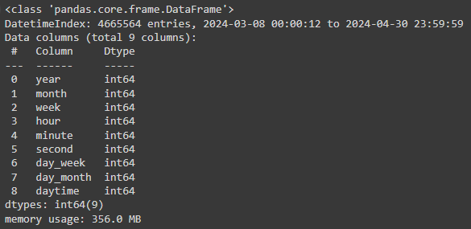
Dataset Description
Transformed Data:

Slide 8
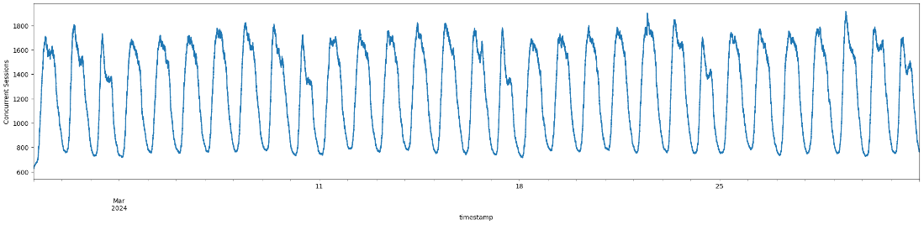
Dataset Description

Slide 9
The Approach

Slide 10
The Approach
Methods
XGBoost
LightGBM

Slide 11
The Approach
Methods
XGBoost
LightGBM
Features
Time Related Features
Second, Minute, Hour, Daytime, Weekday, Week, Month, Year

Slide 12
The Approach
Methods
XGBoost
LightGBM
Features
Time Related Features
Second, Minute, Hour, Daytime, Weekday, Week, Month, Year
Target
Concurrent Sessions

Slide 13
The Approach
Methods
XGBoost
LightGBM
Features
Time Related Features
Second, Minute, Hour, Daytime, Weekday, Week, Month, Year
Target
Concurrent Sessions
Baseline
7 Days Shifted Concurrent Sessions

Slide 14
Dataset Description

Slide 15
Evaluation

Slide 16
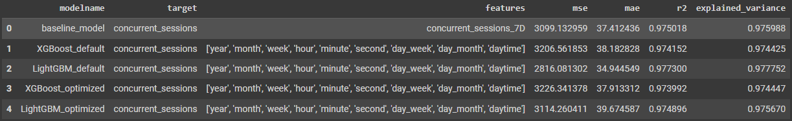
Evaluation

Slide 17
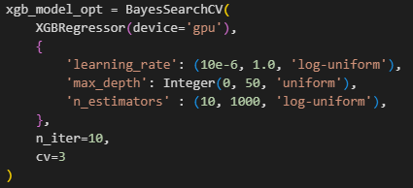
Model Training -
XGBoost

Slide 18
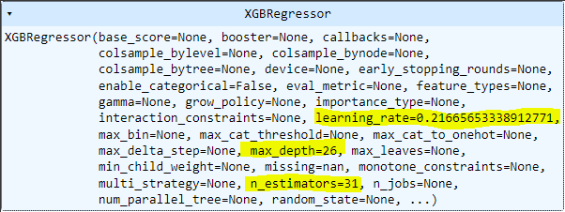
Model Training -
XGBoost

Slide 19
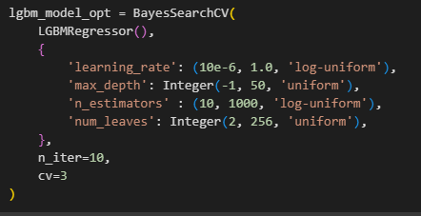
Model Training -
LightGBM

Slide 20

Model Training -
LightGBM

Slide 21
Evaluation

Slide 22
Evaluation

Slide 23
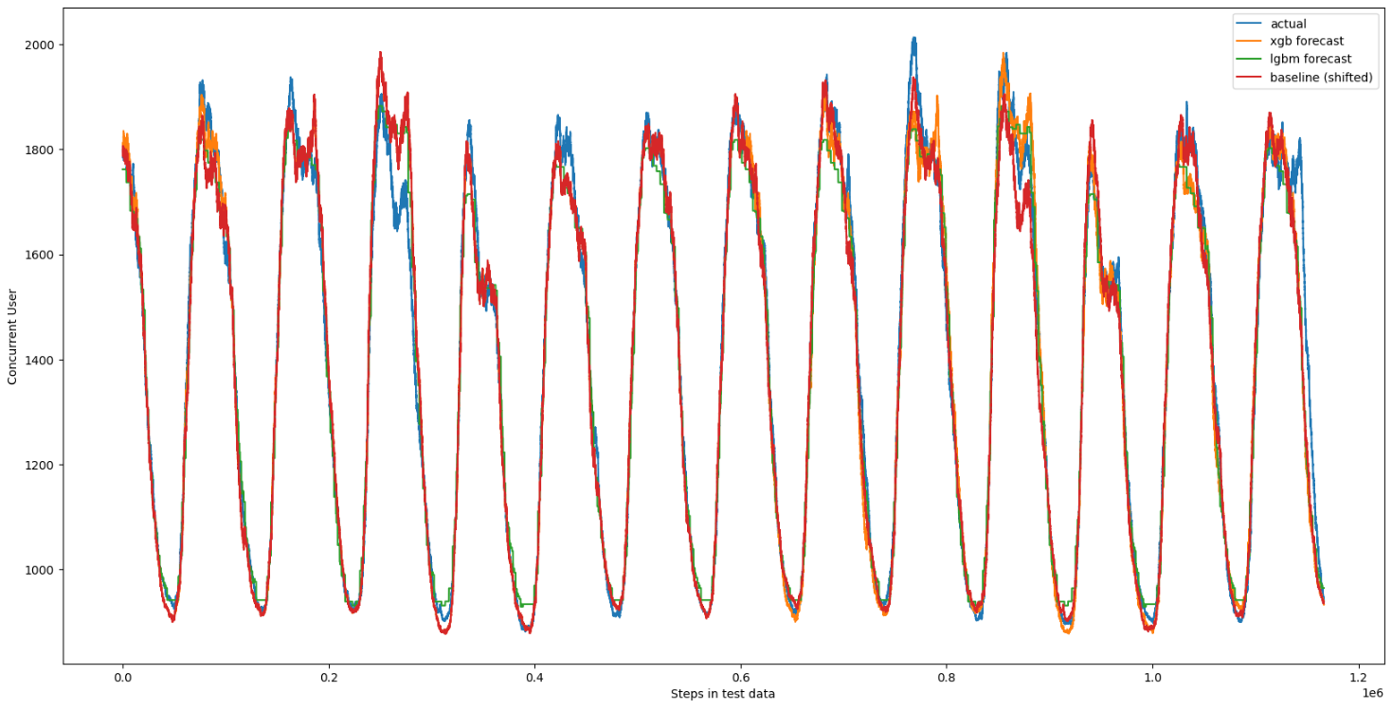
Evaluation

Slide 24
Problems Encountered

Slide 25
Problems Encountered
Large Dataset
Too Many Timestamps
Inapplicability of Certain Algorithms

Slide 26
Ask me your questions!

Slide 27
Thank you for your attention!

